Slide 1

SPIRTUAL TABLET COMPANY

Slide 2

Incorporation as a non- profit co., under sec25 A
Registration in Visakhapatnam
Directors : 5 – 10
Also working on : Patents of logo, title and spiritual tablets , RC for sales and R & D registration

Slide 3


A BRIEF PROFILE
Dhyanarogyam has completed its inception phase and now going to launch their services across the globe under the name of SPIRITUAL TABLETS company

Slide 4

OUR PHILOSHPHY
To play a pivotal role in SPIRITUALISING the EARTH through spreading Vegetarianism, Meditation and Spiritual Science as a primary Health tool.

Slide 5
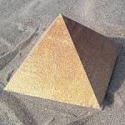

OUR CORE COMPETENCIES
Stability of PYRAMID
New Age Spirituality
Rejuvenating Harmonious Life styles
Unique online services:
Auto-generated solutions
Online counseling
Administrative portal

Slide 6
INTRODUCTION
A group of pyramid Masters and Doctors started Spiritual training to the patients. With this , 1500 patients were well benefited in 2003-04.
In the 2nd phase, 60 meditation health centres were established and 8000 patients took the benefit out of it across 4 states. Eminent masters, well supporting spiritual doctors and lot of spiritual service volunteers formed a group and this became a movement to establish drugless health.
As a part of it, 350 Spiritual Tablets in the form of pocket books, audio visuals and short films were developed to work on intellectual plane to provide perfect health.
Now this group wants to establish SPIRITUAL TABLETS COMPANY on as a non profit co., under sec 25A and will extend their services across the Globe.

Slide 7
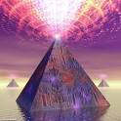


IMPORTANCE OF OUR PRODUCTS & SERVICES
Meditation will perfectly stabilize the energy system in the patients
Pyramid structure will provide amplified energy
Spiritual science in the form of spiritual tablets will change the person’s unscientific belief systems and will make them to understand the PURPOSE OF LIFE very well. Purposeful life is the key for healthy and happy life.

Slide 8


BENEFITS OF OUR PRODUCTS & SERVICES
Perfect energy balance
All physical, mental and social ailments will be cured
Mental peace will be achieved
Stress free life will be achieved
Meaning of life is well understood
Global-Environment Harmony is attained.

Slide 9
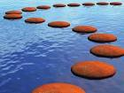

ORGANIZATION VIEWS
To establish 1000 meditation health centres on Franchisee basis across the globe
To tie-up and establish spiritual health care centres
To construct 50 holistic centres
To emphasise our services through online, as mostly required by the generation.

Slide 10


ORGANIZATION VIEWS
To provide meditation health services from rural masses to corporates
To create intense awareness among the people that “spiritual intellect is the root and physical health is the fruit”.
Research and Development to establish ‘Spiritual Health Science Method’.

Slide 11
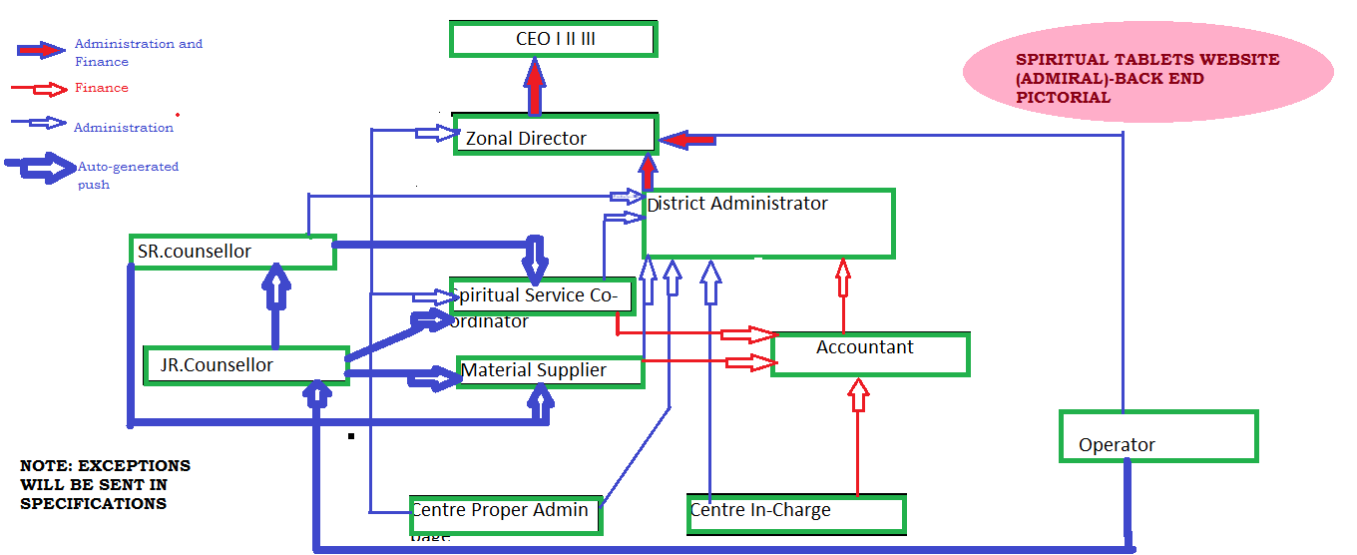
Organization Structure

Slide 12
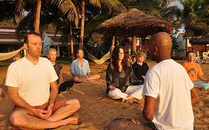

OUR PRODUCTS & SERVICES
Teaching meditation
Spiritual health science workshops
Spiritual health counselling
Spiritual tablets in the form of books, audio-visuals and short films.

Slide 13


OUR PRODUCTS & SERVICES
Natural spiritual health retreats
Pyramids and other energy amplifiers
Spirituo -Scientific Cultural events.

Slide 14



OUR SPECIAL CAPSULES
Dreams, co-incidences analysis and material symbolisms for spiritual evolution
In-house spiritual training workshops

Slide 15
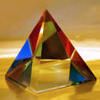

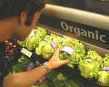
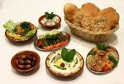
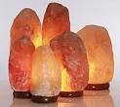
OUR OTHER PRODUCTS
We also have products and services offered by:
Enjoyment science academy
Pyramid spiritual science academy
Pyramid power awareness trust
Vegan and organic food.
Other spiritual goods.

Slide 16

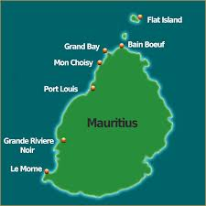

MAJOR ASSIGNMENTS WE HANDLED
Created extensive awareness of meditation, vegetarianism and pyramid power among the rural masses
Established 60 health care centres as part of Dhyanarogyam project and about 10,000 people got benefited.
Played a key role in taking up and supporting the Pyramid Spiritual Societies movement in a various states in India, Andaman & Nicobar islands and Mauritius.

Slide 17


MAJOR ASSIGNMENTS WE HANDLED
Played a key role in initiation and creating a base for Enjoyment science academy, Pyramid Spiritual Science Academy, Pyramid Power Awareness Trust.
Took active part in the major workshops, activities and events conducted by Indian Federation of Spiritual Scientists.

Slide 18


BENEFITS
Be a Part of this divine global spiritual movement and express unconditional love, attain oneness and path way of salvation.

Slide 19


PRICING
One day, two day spiritual health science workshops for patients will be offered on member donation basis.
Spiritual health counselling will be offered on member donation basis.
Spiritual tablets certification will be offered on member donation basis.
Spiritual products are offered at nominal cost

Slide 20

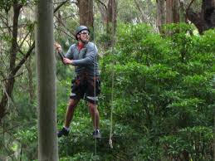
PRICING
Services and products of affiliated organisations will be offered as per their terms.
Spirituo-scientific cultural events will be conducted at the competitive-market price.
Naturo – Spiritual retreats will be offered both at member donation basis and also at competitive- market price to cater all sections of the society.

Slide 21
Our existing Departments and team members on paid, honorarium and voluntary basis. This structure will for an another year :
Man power & Material:
Mrs. Geeta, Ph # 09246648411
Mrs. Maheswari, Ph # 09248430968
Patients workshops
Mrs. Asha,Ph # 09393022988
Spiritual tablets certificate courses Level I & II
Mrs. Vedavati, Ph # 09246990284
Mrs. Sridevi, ph # 08885352809
Spiritual tablets certificate Level III
Dr. G.K., Ph # 09246648410
Mrs. Lakshmi Prasanna , Ph # 09246648425
New centres establishment:
Mrs. Sudha Ph # 09291287580
Maintenance
Kameshwarao, Ph # 09393101801
Corpus fund
Seetha, Ph # 09176603919
Uma, ph # 09059641658
Rajya lakshmi, Ph # 09247870000
Cultural events
Lakshmi, Ph # 09246648405
Sujatha , Ph # 07396490909
Vasundhara, Ph #9032204216
Koteshwara Rao, Ph #
Spiritual health retreats
Das, ph # 09908401235
Chari, Ph #
Subharaju Ph #
Rangamma, Ph #
Satyanarayana, Ph #

Slide 22
Incharge, Spiritual health counsellors
Senior counsellors
Junior counsellors
Incharge, Accounts
Latha, Ph # 09246648409
Incharge, Service Managers
Mrs. Sridevi, ph # 08885352809
Mrs. Lakshmi Prasanna , Ph # 09246648425
In-charge, Website maintenance
Balaji Krishna, Ph #
Harsha, Ph #
Roopa, Ph #
General Promotional Activities
Chandra, Ph #
Satish chakravarthy, ph #
Spiritual tablets @
Text
Naga durga, Ph #
Pradeep, Ph #
Praveena, ph #
Audios & Videos
Venu, ph #
Ramababu, Ph #
Holistic health centres
Pratap, ph #
Praveena, Ph #
Newsletters
Praveena, ph #
Ramya, Ph #
Public Relations
Mrs. Sudha Ph # 09291287580

Slide 23
Co-ordinators (North India)
Mumbai
Kolkata
New Delhi
Co-ordinator (South India)
Bangalore
Chennai
Co-ordinators (Foreign)
Manager, HR
Ms. Prameela Jyothi , 09885629838
Asst. Manager, HR
Vasundhara, ph #

Slide 24
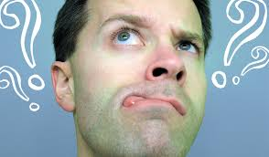

Questions ?

Slide 25


For general details:
Dr. G.K. , Ph # 09246648401
Member Donations:
Mrs. Sridevi, Ph # 08885352809
Email us @ spiritualtablet.org

Slide 26



